Slide 1

Lecture 11
Relational Database Design
Third Normal Form
Addendum
Dr. Jefferson Fong
Reference: 7.3, 7.5

Slide 2
Presentation Sign up
Presentations will be held on Wed Dec 17 and Thu Dec 18
  Talk with your team on your preferred time slot.
  Team leader sign up for time slots on next Wed. (15 teams)
Data and Time | Team
Wed 17 Dec, 10-11 (4 teams)
Wed 17 Dec, 11-noon (4 teams)
Wed 17 Dec, noon-12:20 (2 teams)
Thu 18 Dec, 4:20-5 (3 teams)
Thu 18 Dec, 5-6 (4 teams)
Thu 18 Dec, 6-6:15 (1 team)

Slide 3
Assignment 3
Will be released in iSpace soon (tomorrow?)

Slide 4

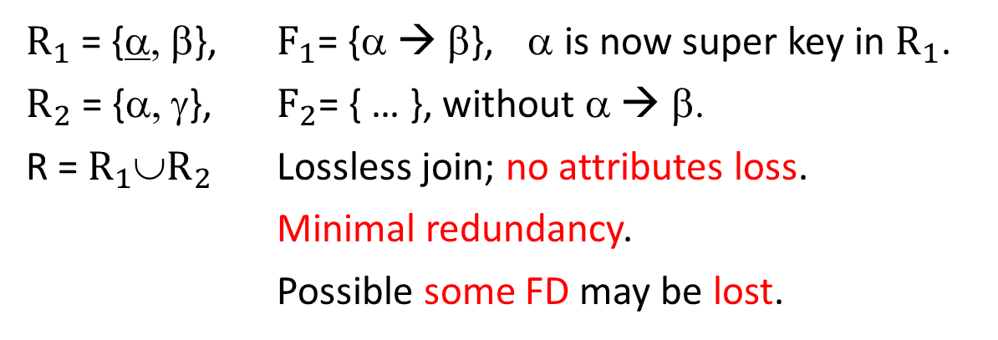

Slide 3 BCNF
R
α | β | γ
R = {α, β, γ}, F = {α → β, …}
If α is not a super key in R, we decompose R and F.
$R_{1}$
$R_{2}$
$R_{1}$ = {α, β}, $F_{1}$= {α → β}, α is now super key in $R_{1}$.
$R_{2}$ = {α, γ}, $F_{2}$= { … }, without α → β.
R = $R_{1}$∪$R_{2}$ Lossless join; no attributes loss.
Minimal redundancy.
Possible some FD may be lost.
α | β
α | γ
U
Alternative to BCNF: Third Normal Form

Slide 5
Third Normal Form
First Normal Form – Domain of all attributes are atomic (Lecture 8).
  Cannot reduce any further.
Second Normal Form – Not used in practice (see book 7.3).
Slide 4
For BCNF, ∀ α→β in F⁺, at least one of conditions 1 and 2 is true.
For 3NF, ∀ α→β in F⁺, at least one of conditions 1, 2 and 3 is true.
  Give the FD one more chance to pass.
Slide 5
  E.g. from the end of Lecture 10, Pros and Cons of BCNF
    In BCNF, we don’t preserve JK → L
  Don’t need to decompose R because it’s in 3NF.
  3rd condition: don’t need to decompose α→β if β is already determined by some candidate key.

Slide 6
Slide 6
No contradictions of the FD’s in the table.
We allow some redundancies in 3NF. (Marked in green in the table.)
  That’s the price we pay for preserving FD’s.
Slide 7
We get a canonical cover for F⁺ by removing all extraneous (unneeded) attributes from each FD.
  After removing the extraneous attributes from the FDs, the closure of the new set is same as the closure of the original set.
  Hopefully your team doesn’t have any extraneous members.
More in Slide 10 ff.

Slide 7
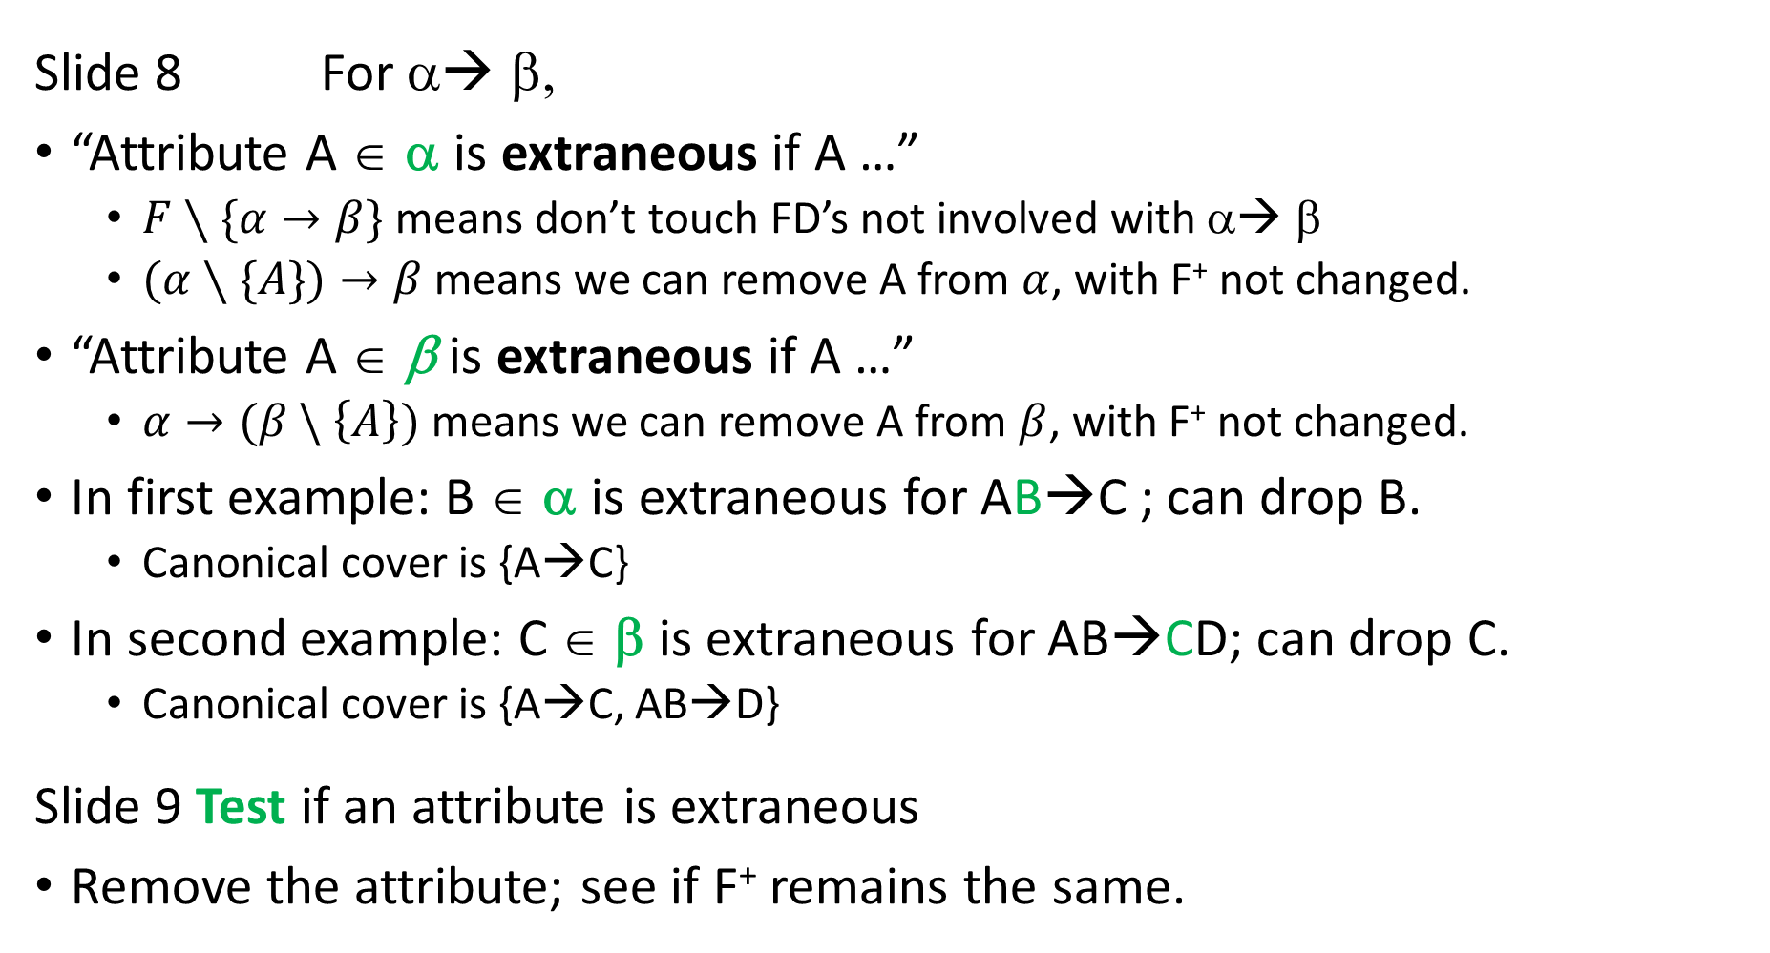
Slide 8 For α◊ β,
“Attribute A ∈ α is extraneous if A …”
  $F∖\{α→β\}$ means don’t touch FD’s not involved with α◊ β
  $(α∖\{A\})→β$ means we can remove A from $α$, with F⁺ not changed.
“Attribute A ∈ β is extraneous if A …”
  $α→(β \backslash \left\{A\right\})$ means we can remove A from $β$, with F⁺ not changed.
In first example: B ∈ α is extraneous for AB→C ; can drop B.
  Canonical cover is {A→C}
In second example: C ∈ β is extraneous for AB→CD; can drop C.
  Canonical cover is {A→C, AB→D}
Slide 9 Test if an attribute is extraneous
Remove the attribute; see if F⁺ remains the same.

Slide 8
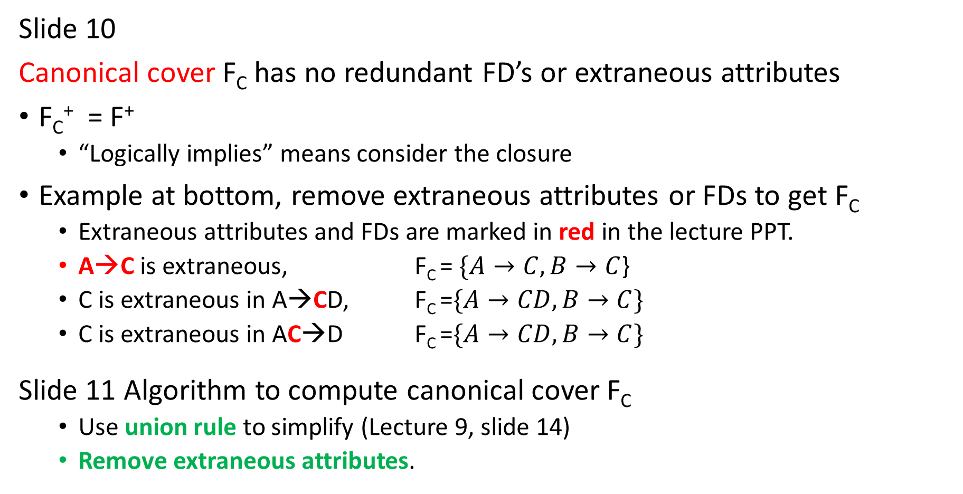
Slide 10
Canonical cover F_{C} has no redundant FD’s or extraneous attributes
F_{C}⁺ = F⁺
  “Logically implies” means consider the closure
Example at bottom, remove extraneous attributes or FDs to get F_{C}
  Extraneous attributes and FDs are marked in red in the lecture PPT.
  A→C is extraneous, F_{C} = $\{A→C,B→C$}
  C is extraneous in A→CD, F_{C} =$\{A→CD,B→C\}$
  C is extraneous in AC→D F_{C} =$\{A→CD,B→C\}$
Slide 11 Algorithm to compute canonical cover F_{C}
  Use union rule to simplify (Lecture 9, slide 14)
  Remove extraneous attributes.

Slide 9
Slide 12 Simple example for algorithm
  Book has more explanations.
Slide 13-17 More Examples, step by step
Note: 1st line has attribute F in set R; 2nd line has F as the FD set.
  These two F’s are different.
First iteration
  First few FDs don’t look extraneous; new attributes are used at each new FDs; until we get to ACD → B.
Second iteration
  Union AC → G with AC → B to get AC → BG
(This is long.)

Slide 10

4th iteration:
Consider $CE→AG$. What happens if we get rid of G?
Start with $CE→A$. Can we get G?
We got A. How do we get B? $AC→B$. … Finally, $D→EG$; we got G!!

Slide 11
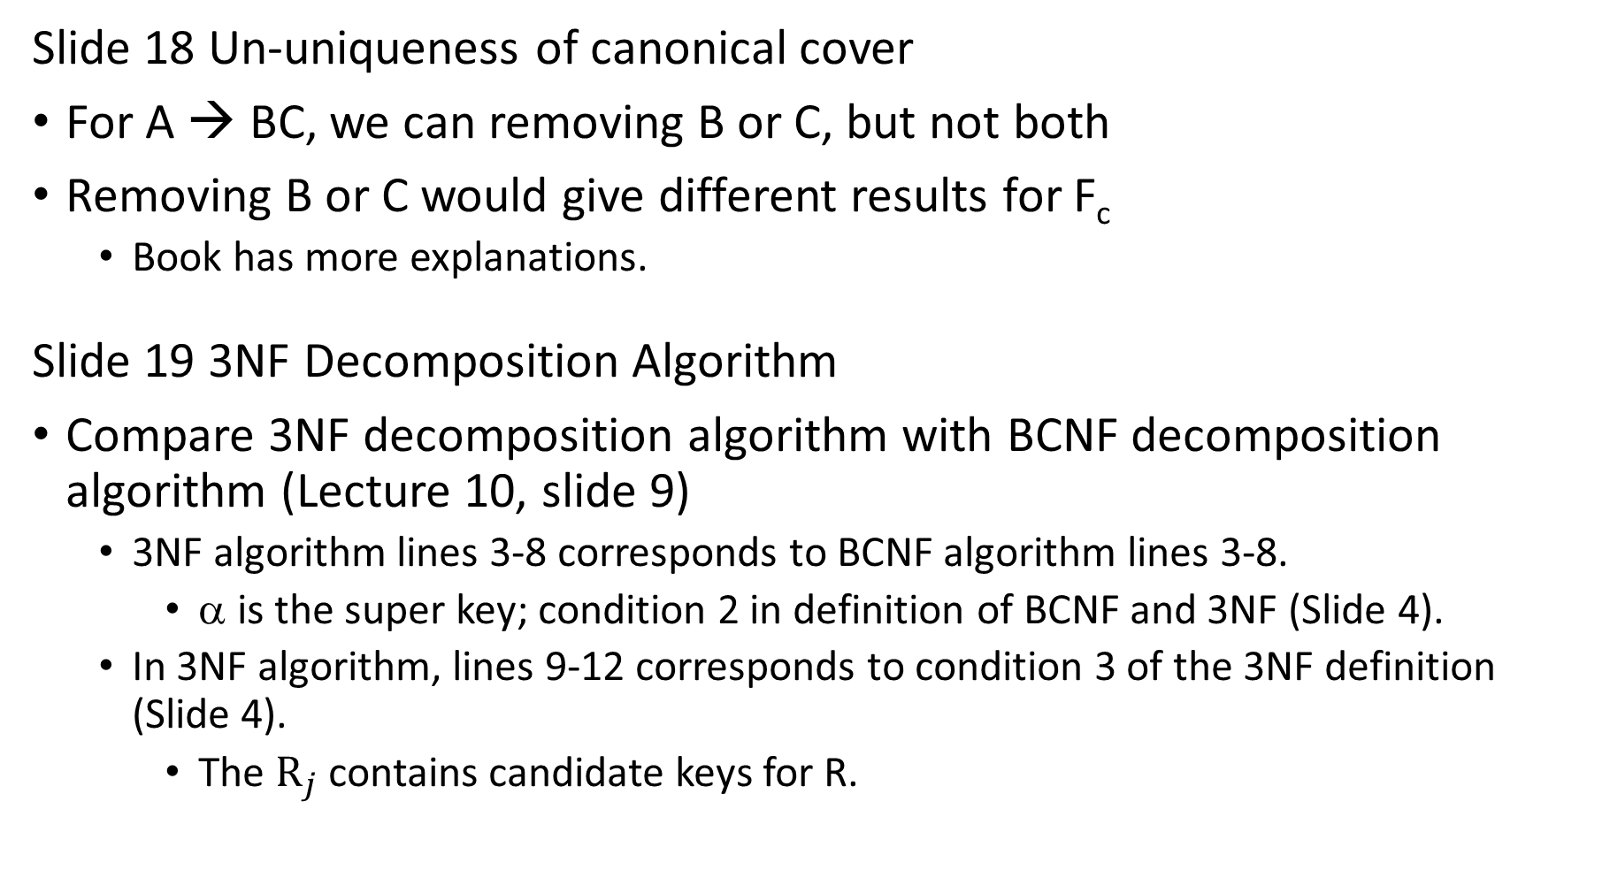
Slide 18 Un-uniqueness of canonical cover
For A → BC, we can removing B or C, but not both
Removing B or C would give different results for F_{c}
  Book has more explanations.
Slide 19 3NF Decomposition Algorithm
Compare 3NF decomposition algorithm with BCNF decomposition algorithm (Lecture 10, slide 9)
  3NF algorithm lines 3-8 corresponds to BCNF algorithm lines 3-8.
    α is the super key; condition 2 in definition of BCNF and 3NF (Slide 4).
  In 3NF algorithm, lines 9-12 corresponds to condition 3 of the 3NF definition (Slide 4).
    The $R_{j}$ contains candidate keys for R.

Slide 12
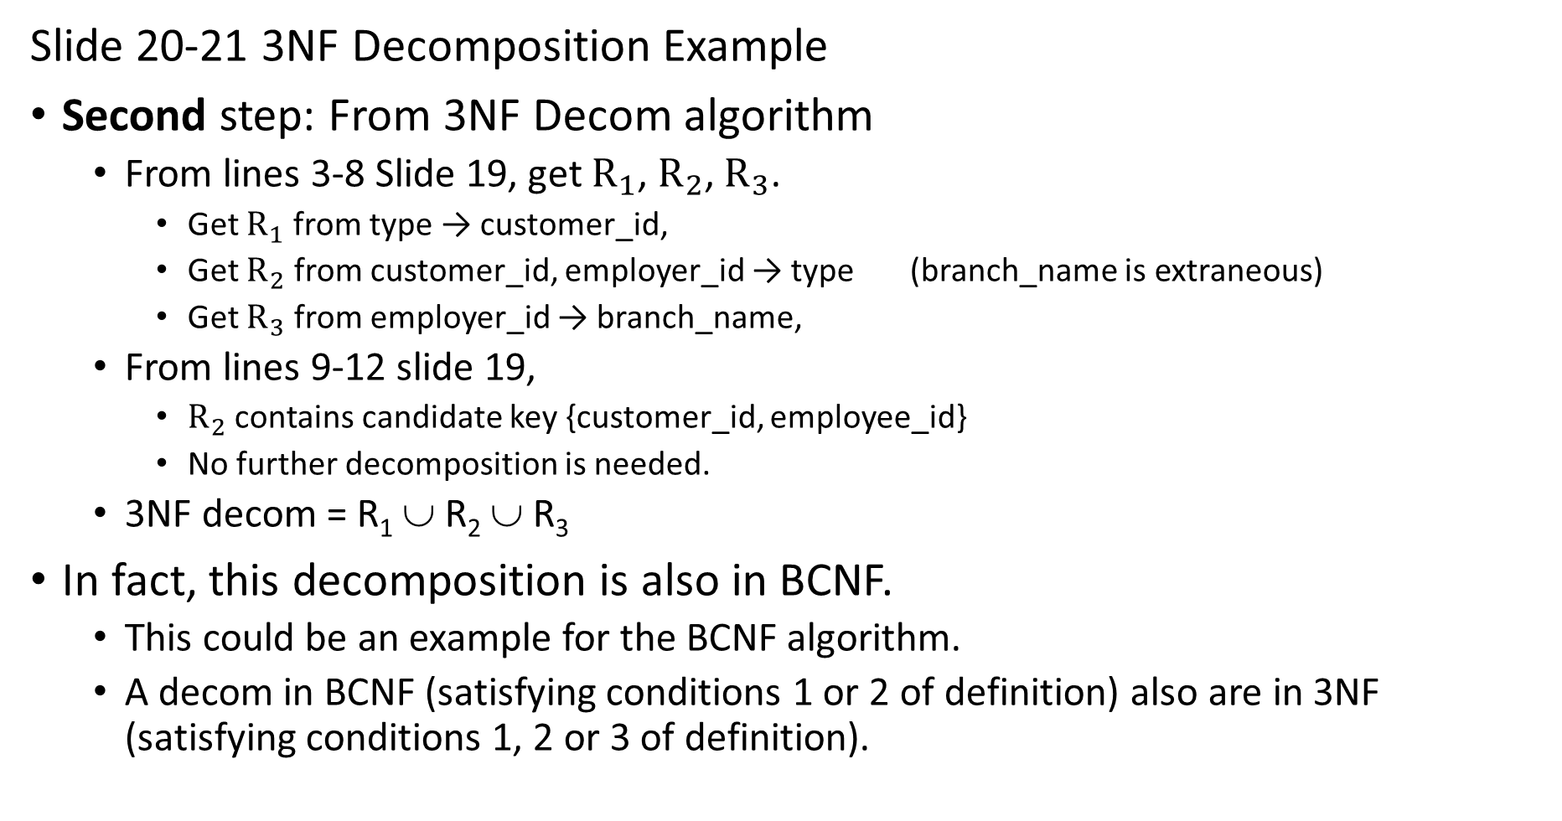
Slide 20-21 3NF Decomposition Example
Second step: From 3NF Decom algorithm
  From lines 3-8 Slide 19, get $R_{1}$, $R_{2}$, $R_{3}$.
    Get $R_{1}$ from type → customer_id,
    Get $R_{2}$ from customer_id, employer_id → type (branch_name is extraneous)
    Get $R_{3}$ from employer_id → branch_name,
  From lines 9-12 slide 19,
    $R_{2}$ contains candidate key {customer_id, employee_id}
    No further decomposition is needed.
  3NF decom = R₁ ∪ R₂ ∪ R₃
In fact, this decomposition is also in BCNF.
  This could be an example for the BCNF algorithm.
  A decom in BCNF (satisfying conditions 1 or 2 of definition) also are in 3NF (satisfying conditions 1, 2 or 3 of definition).

Slide 13
Slide 22
Suppose in Step 2, we first do FD2 customer_id, employee_id → type.
  Get R′₁ = {customer_id, employee_id, type}
Then we do FD1 type → customer_id
  {customer_id} \ {type} = {customer_id} is in the candidate key for R; see 3rd condition in the 3NF definition, Slide 4.
  So don’t need to decompose for this FD.
Then do FD3 employer_id → branch_name.
  Get R′₂ = {employee_id, branch_name}
3NF decom = R′₁ ∪ R′₂
This 3NF is different than last slide, and is not in BCNF.

Slide 14
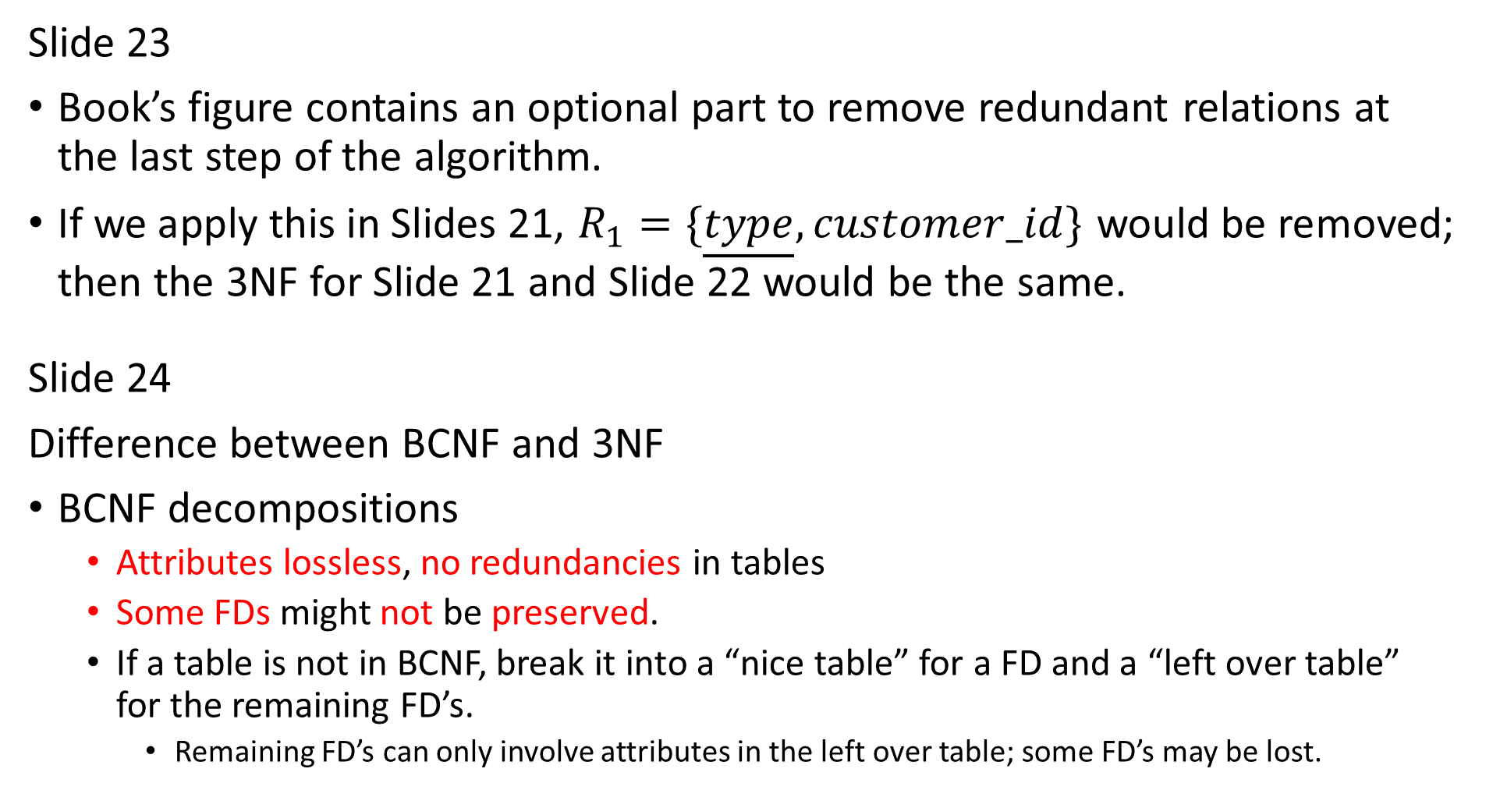
Slide 23
Book’s figure contains an optional part to remove redundant relations at the last step of the algorithm.
If we apply this in Slides 21, $R_{1}=\{\underline{type}, customer_id\}$ would be removed; then the 3NF for Slide 21 and Slide 22 would be the same.
Slide 24
Difference between BCNF and 3NF
BCNF decompositions
  Attributes lossless, no redundancies in tables
  Some FDs might not be preserved.
  If a table is not in BCNF, break it into a “nice table” for a FD and a “left over table” for the remaining FD’s.
    Remaining FD’s can only involve attributes in the left over table; some FD’s may be lost.

Slide 15
Slide 24
3NF decompositions
  Attributes are lossless, FDs preserved
  Might have some redundancies in tables
  In a canonical cover (F⁺ with all extraneous FD’s removed), check every FD to see if it satisfied 3NF.
    If not, decompose the table for that FD to make it satisfy 3NF.
    We must keep every FD from the canonical cover.
Next week, we will do more examples for BCNF.
Do 3NF for simple case? F={A→B, B→C, C →A}

Slide 16
Do intro to lab.
Remember: discuss with your team on the time slot you want to present.
  Sign up on Wed 3 Dec in class.

